Slide 1

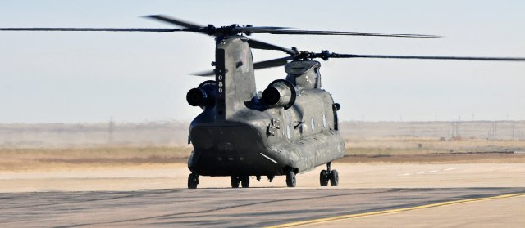
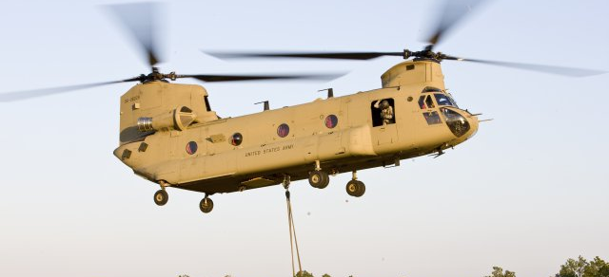
Derivatives over new development
A study of the CH-47F/G Chinook Contracting post 9/11
Meghan Wright
Charleston, SC
7 March 2016
Notes:
Image Sources:
Runway picture (http://www.army.mil/media/281741)
Flight (http://www.army.mil/article/65943/Chinook_turns_50__looks_toward_future/)

Slide 2

Program History
Over 50 Years of Service to the US Army and marines
CH-47A entered active service August 1962
Primary mission is medium lift for troop and supply transport
7 models produced for the US Military including one for Special Forces
Central to military strategy in the Vietnam War, Gulf Wars, Afghanistan and Iraq as well as humanitarian support across the world
CH-47C fleet rebuilt and upgraded and new purchases made to create CH-47D fleet after Vietnam war.
CH-47D was opened for Foreign Military sales, with 20 international allies operating the aircraft.
Source: The Boeing Company (see notes)
Notes:
Source:
“Historical Snapshot: Ch-47 Chinook”. The Boeing Company. Accessed 4 Mar. 2016. http://www.boeing.com/history/products/ch47-chinook.page

Slide 3

Proposed Fleet Upgrade
Army Aircraft modernization report
Why?
CH-47 F/G Proposal
CH-47D fleet is aging and reliability lower than required
CH-47 Chinook now only medium/heavy lift helicopter in Army Fleet
Delay development of new helicopter ($$)
Central to army and special forces operations
Improved engines to extend range
Purchase new aircraft and rebuild existing (extend current fleet’s life by 20 years)
Upgraded air frame
Modern flight deck
~$600/hr reduction in operating costs

Slide 4
Contracts
CH-47F EMD Contract (1998)
  $76.1M for delivery of 2 prototype aircraft
  Completed in 2002
  Nunn-McGrady Breach in 2001
CH-47F LRIP Lot 1 Contract (2003)
  1 CH-47F, 6 MH-47G for $152.6M
  Contract reprioritized after 9/11 due to increased mission demands
MH-47G LRIP Lot II Contract
  16 MH-47G
Full-Rate Production
  Remaining of $5.4B for procurement
  3 Blocks – 14 MH-47G and 300 CH-47F
MYII Contract (2011)
  $4.9B for 155 new CH-47F with options for 60 additional aircraft
  $810M in cost-savings for government
Sources: see notes
Notes:
“Acquisition of the CH-47F Improved Cargo Helicopter (D-2004-046)”. Department of Defense, United States Government. Office of the Inspector General. 21 January 2003
http://www.army.mil/article/105654/Team_Chinook_signs_CH_47F_MYII_contract-cost_savings_of810_million/

Slide 5
Major events
1997-1998: delays in finalizing Operational Requirement Document (ORD) which is required for development
ORD did not meet Army’s Interoperability requirements
9/11 led militarization in preparation for potential conflicts
Nunn-McCurdy breach in 2001 – 95% cost growth during EMD Phase
2006 – First direct commercial sale of CH-47 to Netherlands
Sources: see notes
Notes:
Acquisition of the CH-47F Improved Cargo Helicopter (D-2004-046)”. Department of Defense, United States Government. Office of the Inspector General. 21 January 2003
“Vertical Lift Industrial Base Report” http://www.acq.osd.mil/mibp/docs/vertical_lift_industrial_base_report.pdf
http://www.nationaldefensemagazine.org/archive/2014/October/Pages/InternationalChinookSalesPoisedtoKeepBoeingHumming.aspx

Slide 6
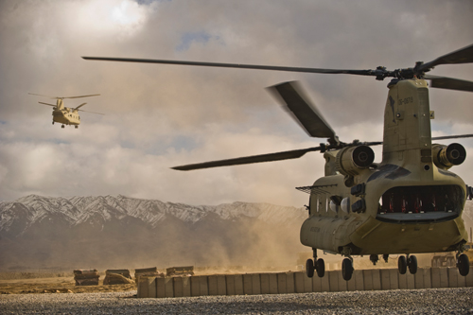
FOL 2 – Cost Rules
Partnership between Boeing and the Army enabled program cost reductions
Nunn-McCurdy breach led to increased program scrutiny and oversight
Army chose derivative over new development because it’s a fraction of the cost
Foreign Military Sales/Direct Commercial Sales decrease unit cost
Sources: see notes
Notes:
http://www.nationaldefensemagazine.org/archive/2014/October/Pages/InternationalChinookSalesPoisedtoKeepBoeingHumming.aspx

Slide 7
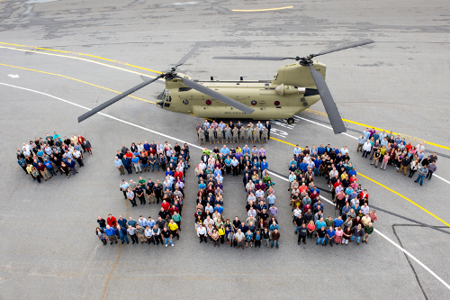
FOL 3 – Strong, coherent constituency
Storied service history, beloved aircraft by customer
Definitive need for aircraft, especially post 9/11
Strategy proposed by constituency worked with CH-47C to CH-47D upgrades
Army and Marines are a formidable and united constituency
Boeing and DoD work closely for mutual benefit of customer - trust
International customers provide strong support for constituency
Notes:
Image source: http://boeing.mediaroom.com/2014-10-27-Boeing-Delivers-300th-CH-47F-Chinook-to-U-S-Army-Ahead-of-Schedule#assets_117

Slide 8
Research Sources and Direction
Acquisition Reports (GAO)
  CH-47F/MH-47G Reports for initial contracting, program reviews post Nunn-McCurdy Breach
  Intent: results of GAO investigations on program status and events.
NDIA Magazine
  Industry articles on important events related to program events/accomplishment
  Intent: brings together government events, public reactions and external influences
Army Reports
  Vertical Lift Industrial Base Report, Army Aircraft Modernization Study
  Intent: constituency’s intent, program status and goals
Customer/Contractor Articles
  Boeing, Army and Marine websites and press releases
  Intent: general program information, milestones, customer reactions

Slide 9
Questions?

