Slide 1

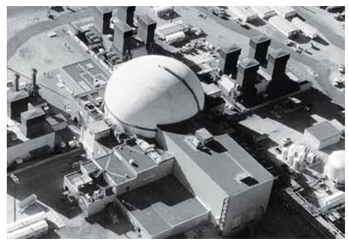
Fast Flux Test
Facility (FFTF)
A Case Study of FFTF using the Facts of Life
Pictured: Fast Flux Test Facility at Hanford, Washington
(Source: Federation of American Scientists)
Emily Vetterick

Slide 2
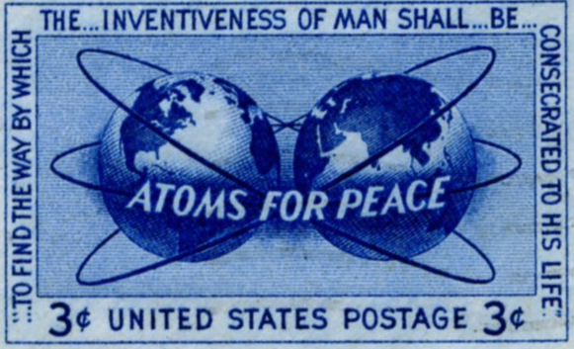
Background Information
Nuclear Energy and Relevant Factors
Nuclear Energy – how is it made?
  Evolution of reactor design concepts
    Light Water Reactor
    Breeder Reactor
Is Nuclear Energy Unsafe?
  Average American
  Propaganda on both sides
Prototype Breeder Reactors in the US
Plutonium Breeder Reactor Program
  Part 1: FFTF - Fast Flux Test Facility
  Part 2: CRBR - Clinch River Breeder Reactor
  Part 3: Full Scale Commercial Breeder Reactor Prototype
Photo Source: Stamp Collecting Website
http://www.theswedishtiger.com/x1955.html)

Slide 3
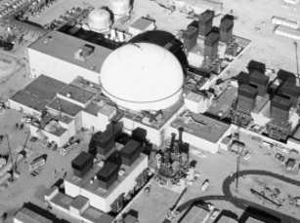
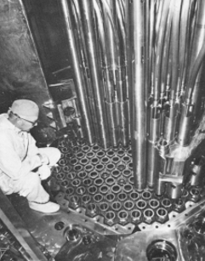
Fast Flux Test Facility (FFTF)
The Program Specifics
1967 Original Authorization for the program
1975 Update to the plan
The Actuals
The FFTF Site
Photo Source: Article entitled “Save the Fast Flux Test Facility”
The Fuel Assembly for the FFTF
Photo Source: Article entitled “Save the Fast Flux Test Facility”

Slide 4
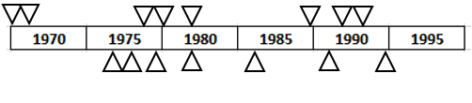
Fast Flux Test Facility (FFTF)
The Timeline and Facts of Life
FFTF Fully Operational
FFTF Operations End
FFTF Build Starts
FFTF Build Complete
FFTF Begins Major Tests
EPA/State Agreement
FFTF Shutdown
President Nixon
President Ford
3-Mile
Island
President Reagan
Chernobyl Disaster
Cold War
Ends
Other Breeders Shut Down
President Carter

Slide 5
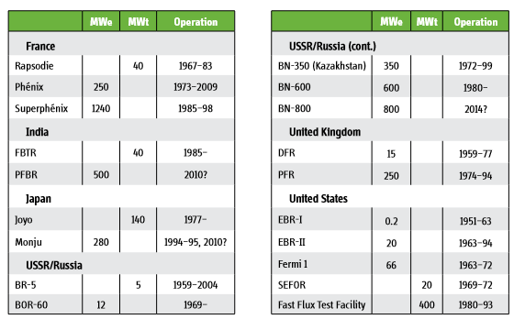
Fast Flux Test Facility (FFTF)
Speaking of Other Breeder Reactors…

Slide 6
The FFTF and Similar Reactors Worldwide
New FOLs?
Political FOL’s vary by country
  European Union
  Russia
Culture Matters – Safety
  Little impact to the reactor program: India, Russia
  Significant Impact to the reactor: Japan, UK

Slide 7
Fast Flux Test Facility (FFTF)
Research Used
Papers, Bulletins, Reports
  Research Report 8: International Panel on Fissile Materials (Fast Breeder Reactor Programs: History and Status)
  Bulletin of Atomic Scientists – 2004; Abbots Long Slow Death of FFTF
  Fast Breeder Reactor Programs: History and Status
  Fast Flux Test Facility Briefing Book 3 (Technical and Economic Viability of Future FFTF Operation)
  International Working Group on Fast Reactors – Eighth Annual Meeting (1975)
  Hanford Cleanup, The First 25 Years
Books
  The Demise of Nuclear Energy? Lessons for Democratic Control of Technology

