Slide 1
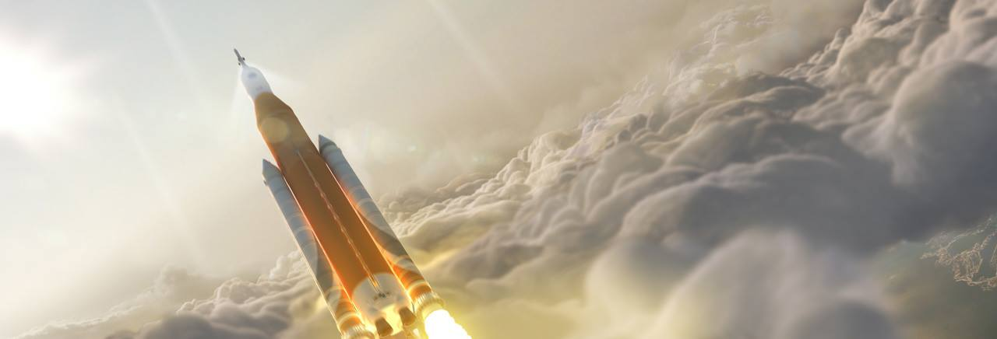

The Space Launch System and
The Political Facts of Life
USC SAE 550
Spring 2016
Nicole Valderrábano
Photo Credit: boeing.com/space/space-launch-system/
Notes:
Hello, my name is Nicole Valderrabano and I decided to look into a newer government sponsored program – the Space launch system, or SLS

Slide 2
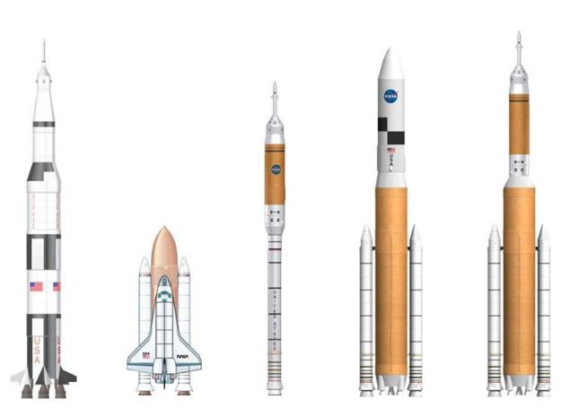
The Evolution of U.S
Launch Systems
Major Launch Systems
  The Atlas D - V
  The Thor/Delta I - IV
  The Titan I - IV
  The Saturn I - V
  The Shuttle Program
The Birth of the SLS
  The Constellation Program
  The US needed a replacement program for the shuttle
Photo Credit: NASA.gov/sls
Notes:
So some information about how the SLS came about:
During the 1960s Cold War, the US was determined to maintain a lead in space technology ahead of Russia and through this effort decided to send an astronaut to space. In this time period, Intercontinental Ballistic Missiles – which were derivatives of V-2 rockets - had been previously employed to support WWII endeavors and made a good design base for a rocket.
“The Atlas D launch vehicle became operational in mid-1959. It carried John Glenn on his first orbital flight in 1962 as part of the Mercury-Atlas Program.” (http://www.aerospace.org/crosslinkmag/spring-2010/launch-vehicles-then-and-now-50-years-of-evolution/)
Up until the late 90s, the design of the Atlas improved into a series of evolved expendable launch vehicles.
Additionally, the Thor launch vehicle – another ballistic missile program derivative was developed to launch satellites from Vandenberg California in the late 50s and early 60s. This Launch vehicle design eventually evolved into the Delta rockets.
Another Launch vehicle used primarily in the mid 60s to the late 80s was the Titan Launch vehicle which was known for its high payload capacity.
In addition to backing satellite launches, some of these vehicles namely the Atlas and the Saturn supported human spaceflight, perhaps most notably, the Apollo missions.
Post-Apollo, the shuttle program was conceived as a solution to build the international space station amongst NASAs other plans. This program was extremely successful with its ISS missions spanning 30 years.
An additional program in the early 2000s was NASAs Constellation Program which had a goal to finish building the ISS and to return to the moon. This program was eventually cancelled by the Obama administration.
With the conclusion of the shuttle program and the cancellation of the Constellation program, NASA sought to continue with a new space program to further human space exploration. Thus the Space Launch System was born.

Slide 3
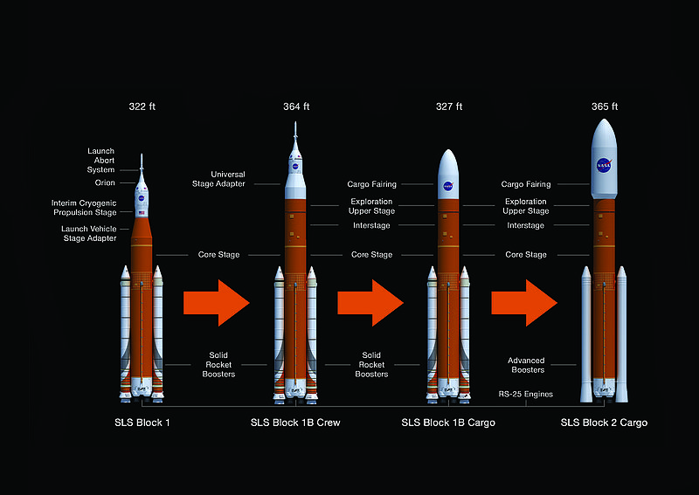
SLS Goals and Capabilities
Heavy Lift Launch Vehicle proposed by NASA
Supports the Orion Crew Capsule
Used to complete deep space exploration, lunar, asteroid, and Martian missions
Current plans dictate that the launch vehicle will be completed in three blocks
  Core stage and four main engines
  Exploration upper stage
  Additional boosters
Photo Credit: nasa.gov/explorationsystems/sls
Notes:
Announced in 2011, the Space Launch System (SLS) is a heavy lift launch vehicle proposed by NASA with a purpose to meet the new challenges of expanding space exploration projects.
The Launch system is to be used in conjunction with the Orion Multipurpose Crew Vehicle which is a space habitat designed to support deep manned-deep space missions for exploration, to conduct research, and to resupply the International Space Station as needed.
The multipurpose design of the SLS will be capable of completing deep space exploration, lunar, asteroid, and Martian missions. Current plans propose the launch vehicle will be completed in three blocks:
Block 1 will consist of a core stage and four main engines. Proposed missions currently include a mission beyond the moon, a delivery to the ISS, and an Asteroid Redirect mission (which will use robotics to collect smaller asteroids and redirect them into a new orbit)
Block 1B will add on an exploration upper stage to propel mission payloads further out. Some proposed missions include a lunar sample retrieval mission and sending payloads into LEO to prepare for a future mission to Mars
Block 2 and the third and final enhancement comprises additional boosters. The launch vehicle will have a lift capacity that is similar to that of the Saturn V (130 metric tons) and will supposedly be able to complete a manned mission to mars and may even support an interstellar probe mission similar to the Voyager missions

Slide 4
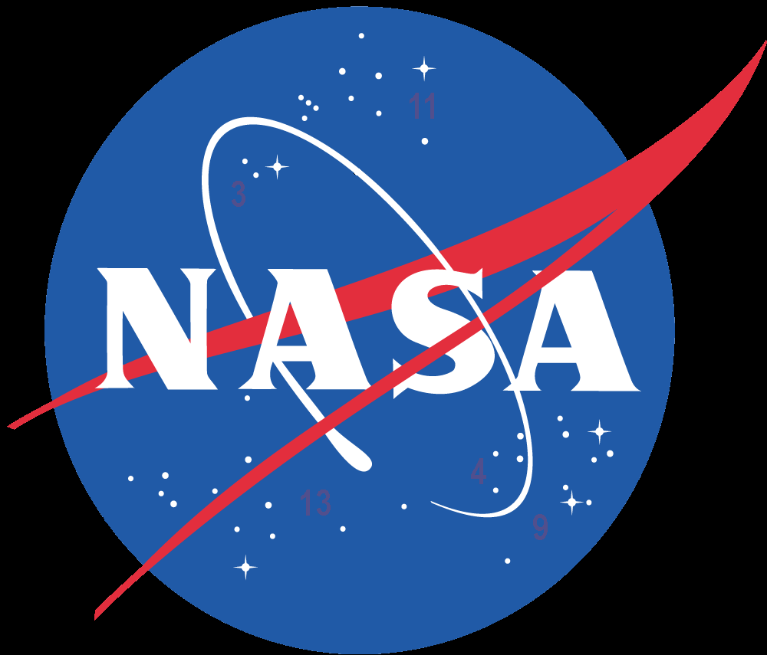
Supporters and opposition
Supporters
  Congress
  NASA
Opposition
  Aerospace Industry
  SpaceX – Elon Musk
  Chris Kraft – First Manned Spaceflight Director
  Lori Garter – Former NASA Deputy Administrator
  Tom McClintock – Republican Congressman
Opposing Views
  Too expensive, behind schedule?
  Better alternatives to complete same mission: fuels, rockets, Delta, Atlas
  Better alternatives to fund: space gas station
  Cutting into commercial crew funding
  Don’t need heavy lifter
Photo Credit: NASA.gov
Notes:
Already a political controversy, the SLS – supported by NASA and Congress - faces major opposition from congressmen, previous NASA leadership, and a large portion of the space industry.
In addition, need for the SLS has been questioned with the growing commercial programs offering similar launch vehicles with reusable capabilities for less money. One such project is reusable launch vehicles being developed by spacex. Further the SLS is competing for funding with alternative programs and ideas such as a space gas station and the commercial crew program.
Already there has been talk that the program is too expensive and behind schedule

Slide 5
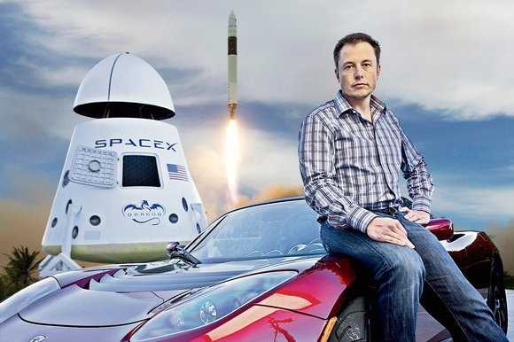
Facts of life
#1: Instead of using new technologically advanced design, propose to use Delta cryogenic second stage to stay on schedule
#2: Congress passed a 4 yr authorization to build heavy lift launch vehicle with insufficient funding based on shuttle methods
#3: Aerospace community not backing the program, lots of opposition
#5: SpaceX design has same or more capabilities for less cost, but is not being funded
Other FOL:
  Politics believes in gurus and heros: Elon Musk, the opposition supports his vision
  A catchy slogan is essential to getting attention – “Senate Launch System” – in this case for the opposition
Photo Credit: pics-about-space.com
Notes:
For FOL #1: Politics, not technology, controls what technology is allowed to achieve
For FOL #2: Cost Rules
FOL #3: A strong coherent constituency is essential
#5: The best engineering solutions are not necessarily the best political solutions

Slide 6
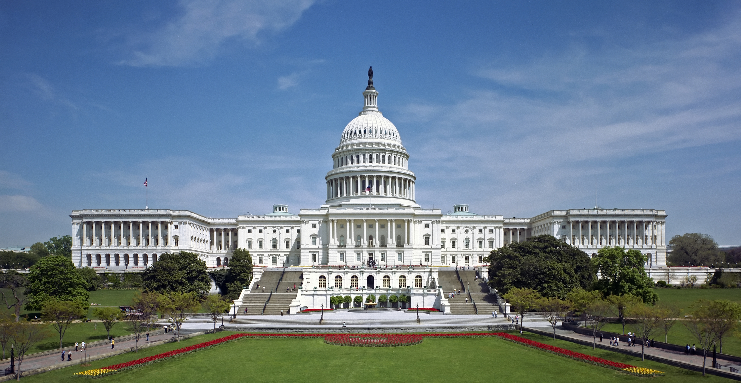
Research sources and topics
NASA archives
  SLS Goals and Performance to Date
  Launch vehicle history
  Director Interviews
Budget Hearings
  President’s Budget Request
Letters from congressmen
  Constituent support/opposition
Design Reports from Contractors (PDRs) and Alternative Program Options
  Boeing, United Launch Alliance, Orbital ATK, Aerojet Rocketdyne
  SpaceX
Photo Credit: theprecidency.org

Slide 7
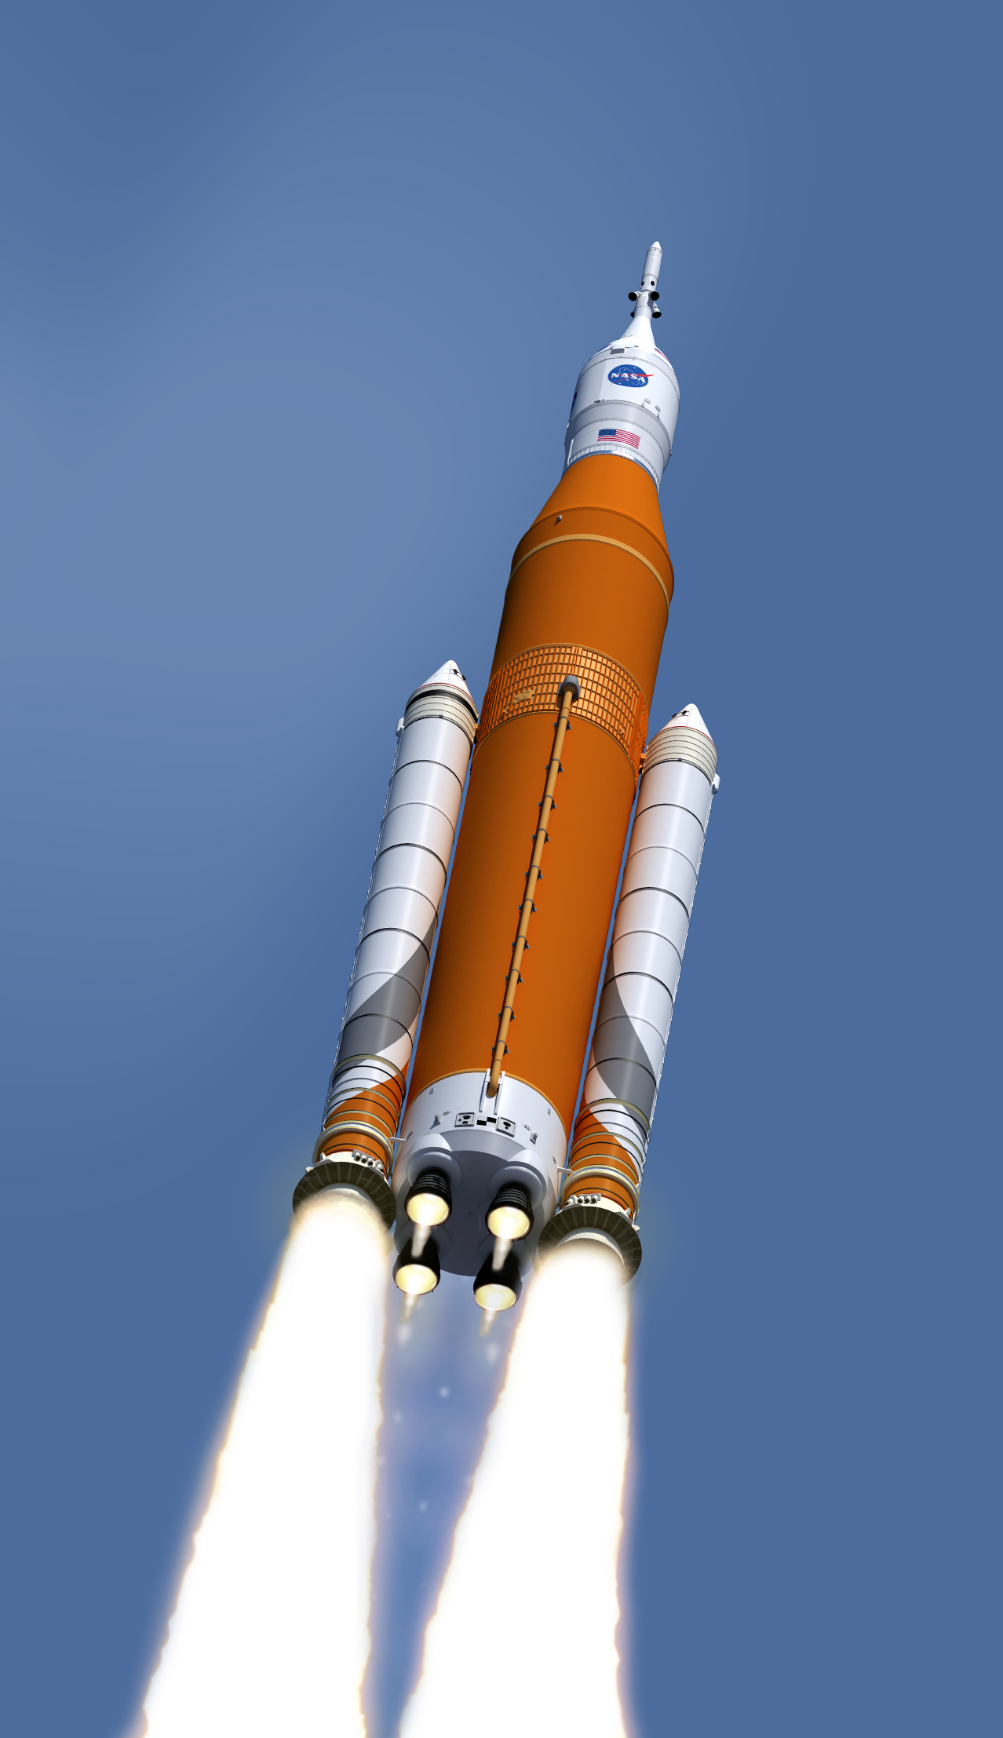
Questions?

