Slide 1

JPSS and NPOESS:
Polar Orbiting Satellite Systems
Alena Rau
SAE 550
3/21/2016

Slide 2
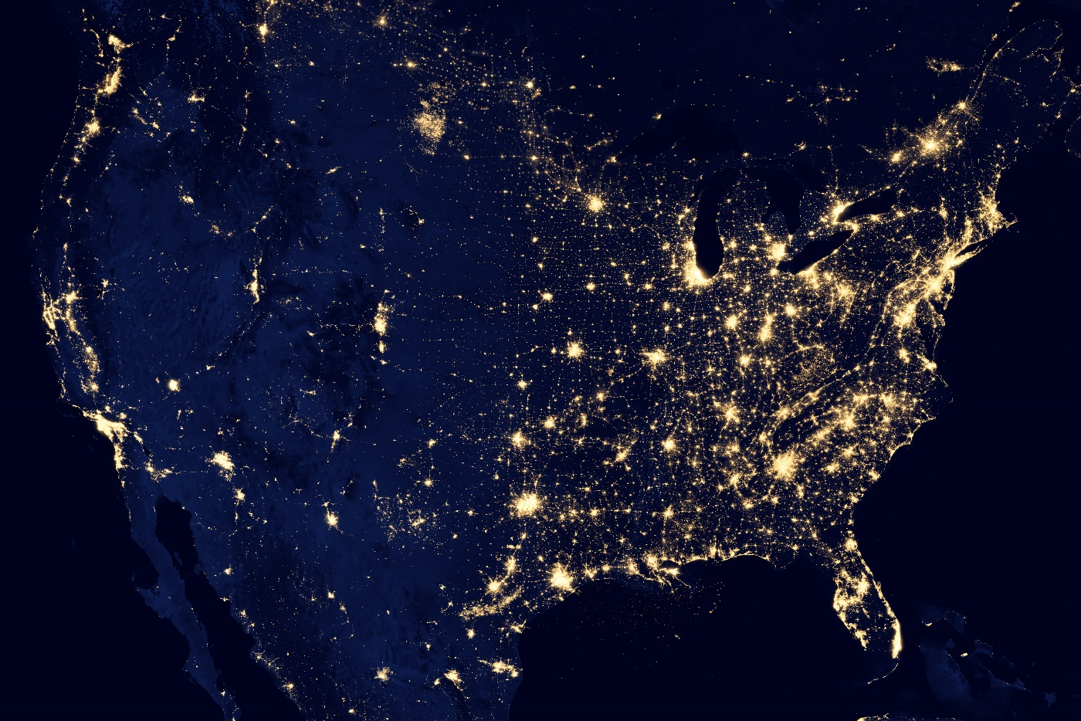
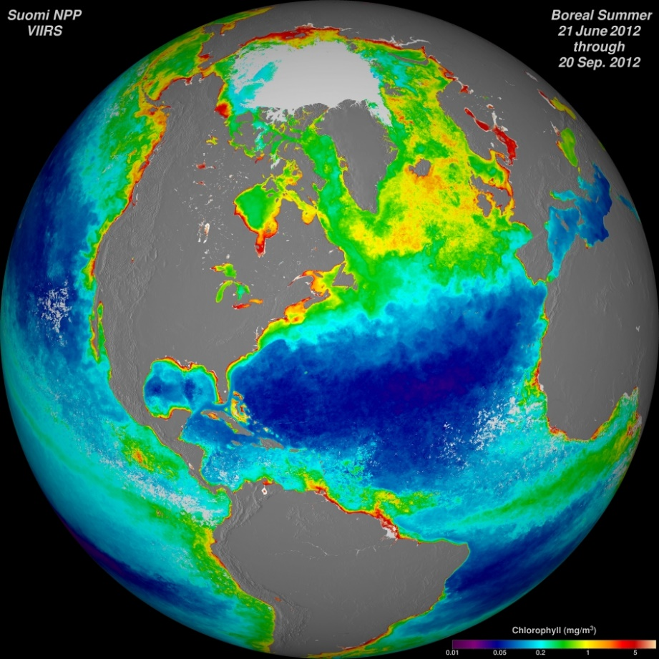
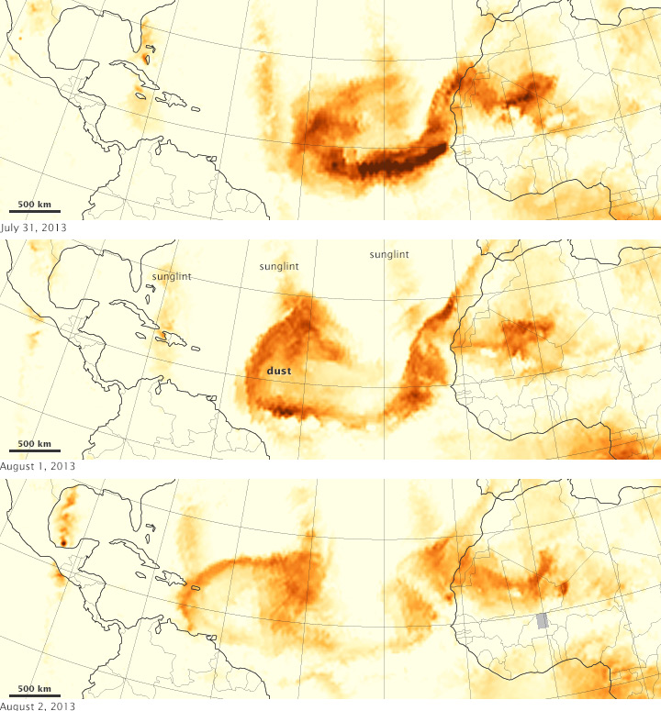
Upper right image: https://www.nasa.gov/mission_pages/NPP/news/earth-at-night.html All other images: http://npp.gsfc.nasa.gov/viirs_sciencegallery.html

Slide 3
History – NPOESS Program
NPOESS (National Polar-orbiting Operational Environmental Satellite System)
Proposed in 1994 to merge Civilian and Defense Weather Satellites
NOAA and DoD joint program with Northrup (then TRW) prime contractor
13 instruments – Large Constituency!
Three Nunn-McCurdy Breaches
  Reduced to 7 instruments, only 2 orbits
  NPP (NPOESS Preparatory Project) flown as full mission
In 2010, program dissolved into JPSS (Civilian) and DWSS (DoD)
  Defense Weather Satellite System (DWSS) Ended in 2012

Slide 4
Current Program –JPSS
Joint Polar Satellite System (JPSS)
  NASA and NOAA project
Same Technology as NPP Satellite currently in Orbit
Weather and Environmental Factors
5 instruments from 5 companies
JPSS-1 to launch end of 2016, JPSS-4 to launch in 2031
Image: www.JPSS.NOAA.gov

Slide 5
Facts of Life
1: Politics Controls Technology
  NPP as full mission
2: Cost Rules
  Program frequently over budget
3: Strong Constituency
  Many contractors, many governmental agencies
4: Technical Problems Become Political Problems
  VIIRS technical problems were a large factor in overruns and political displeasure
5: Best technical solution is not the best political solution
  Reducing sensors and relying on international data

Slide 6
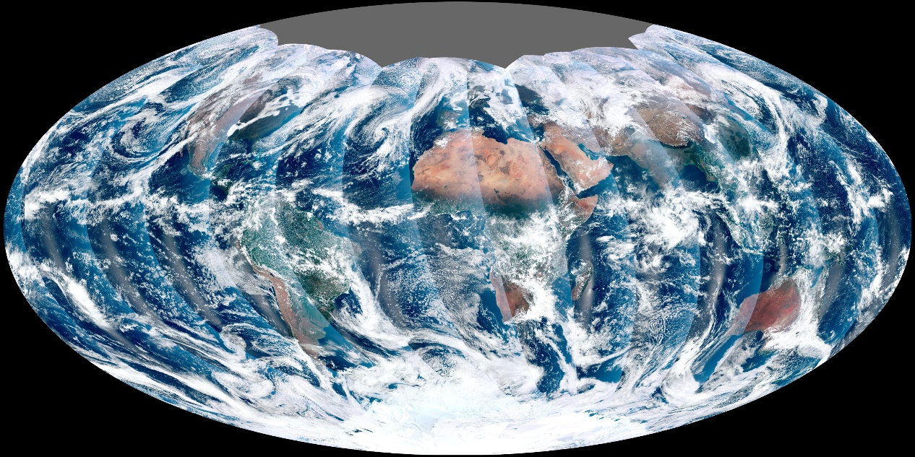
Research Concerns
  Finding official sources for program common knowledge
    For example, hierarchy issues within the overall program
  Separating out different facts of life
  Biased sources
  Scholarly articles for recent events
Image: www.JPSS.NOAA.gov

