Slide 1
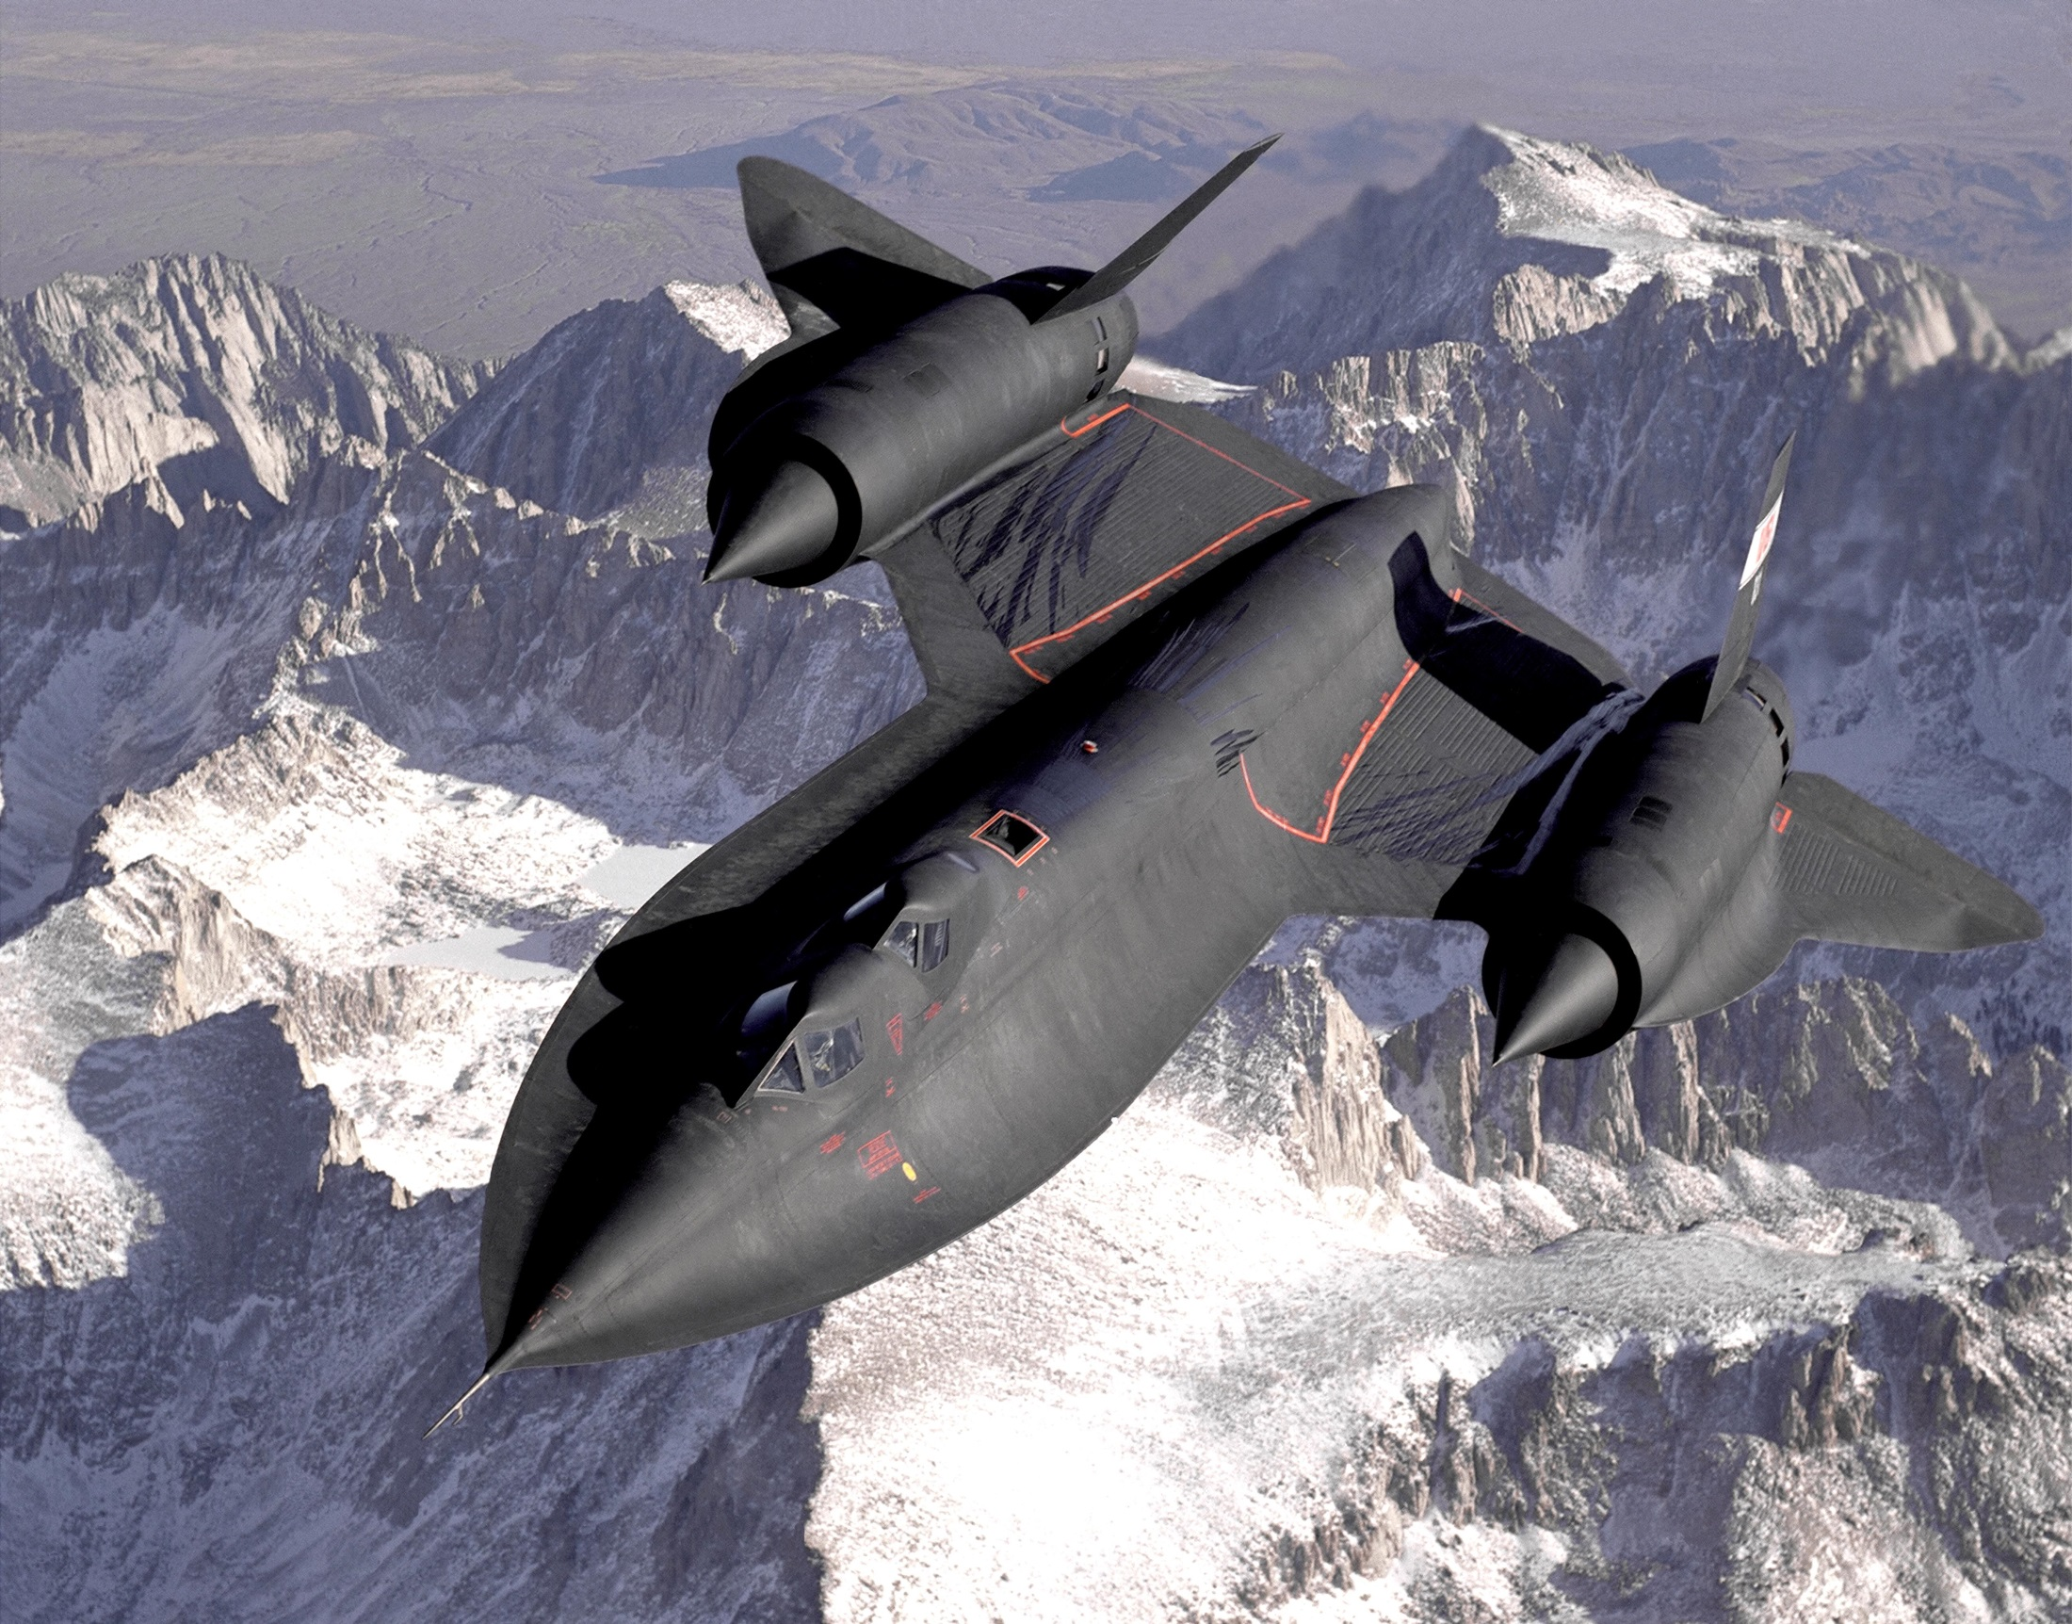
SR-71: A Revolution in Aerospace
Martin F. Holmes
SAE 550: Professor Axelband

Slide 2

Background
MIT Aerospace Engineering w/ PoliSci, Air Force
Cold War with USSR
US developed U-2 to gather overhead intelligence on USSR (missiles, nuclear, submarines, ground forces)
U-2 vulnerability with altitude, velocity, stealth
1959 CIA begins OXCART to develop A-12 with first flight in 1962
1960 loss of Gary Powers U-2 prohibits USSR
CIA transitions program to Air Force who develops SR-71 with first flight in 1964
Record speed (2193 mph) and altitude (85,069 feet)
First serious attempt at stealth technology
Coolest airplane ever!

Slide 3
Why SR-71?
Inventing incredible technology
  Materials: titanium, plastic radar guides and black iron RAM
  Shape: constantly curving body with no sharp edges
  Propulsion: Custom P&W J-58 engine, inlets, special Shell Oil JP-7
  Life support: flight suits to control temperature, pressure, ejection
Impressive contracting
  Classified procurement using CIA authorities
  Lockheed Martin Skunk Works design beats Convair proposal
  Area 51 testing
  Clarence “Kelly” Johnson and Richard Bissell teamwork
Fascinating public and political story
  Gary Powers U-2
  D-21 drone for proposed USSR mission
  Missions in Vietnam, North Korea, Cuba, USSR border, Middle East
  ½ of all UFO sightings
  1990 Retirement
  1995 Comeback
  1998 Retirement

Slide 4
Timeline
1952 Project Aquatone leads to U-2 with expected life of 18-24 months
1957 Scientific Engineering Institute tasked with recommending future, advocates supersonic
1957 MIT President James Killian and Polaroid investor Edwin Land recommend LM A-12 design over Convair
1959 CIA begins OXCART to build twelve A-12s
1960 Gary Powers shot down over USSR, Eisenhower bans USSR overflight
1962 A-12 first flight, Air Force places orders for SR-71
1964 SR-71 first flight
1968 Air Force bases three SR-71 in Japan
1971 SR-71 collects intel on 290 unique USSR radar systems
1982 Air Force bases two SR-71 in England
1990 SR-71 retired due to annual operations cost of $241M
1995 Congress appropriates $100M for reactivation of three SR-71
1998 President Clinton line-item veto of SR-71 ruled unconstitutional by Supreme Court but program still retired

Slide 5
Political Facts of Life
“Politics, Not Technology, Controls What Technology is Allowed to Achieve”
  Capable technology never utilized to full extent against hard-target USSR after Eisenhower banned USSR overflight after U-2
“Cost Rules”
  Original OXCART contract to produce twelve A-12s for $96.6M
  Funding moved from “Black World” to “White World” in 1970s
  Pentagon terminated SR-71 in 1990 due to annual ops at $241M
  Defense Appropriations Bill allocated $100M for reactivation in 1995
  1998 Clinton line-item veto ruled unconstitutional by Supreme Court
“A Strong, Coherent Constituency is Essential”
  Cold War emboldens US citizens, military, and political resolve
  Skunk Works guru Clarence “Kelly” Johnson with 8000 employees
  CIA powerhouse Richard Bissell appointed by D/CIA Allen Dulles
  1957 MIT President James Killian and Polaroid inventor Edwin Land gain trust of President Eisenhower and advocate supersonic OXCART
  Air Force ranked SR-71 as priority #450 in 1977, AF COS James Allen ranked #7, General Jerome O’Malley AF VCOS & SR-71 pilot died 1985

Slide 6
Political Facts of Life
“Technical Problems Become Political Problems”
  Stealth technology still primitive, North Korea commonly targeted and once locked on with SA-2
  125,000 of the 180,000 parts were custom, driving significant cost to maintain industrial base, required expensive maintenance facilities
  Complex inlet-engine design
  Structural based on B-120 titanium caused aircraft to expand several inches at 800°F of Mach 3.3
  Expansion at max speed meant cold aircraft on ground leaked fuel, requires mid-flight fueling
“The Best Technical Solution is not Necessary the Best Political Solution”
  Strategically advantageous to keep existence of SR-71 classified but President Johnson unveiled it in 1964 to combat Presidential Candidate Barry Goldwater claim that JFK was “soft on defense”

Slide 7
Research
Sufficient material available
Classified procurement but documents declassified
Classified nature makes political aspects, positions, stakeholders, and news more limited
Paul F. Crickmore, Lockheed SR-71: The Secret Missions Exposed (London, England: Osprey Aerospace, 1997).
Michael Durkheim, “Air Force SR-71’s Resume Operations.” Aviation Week & Space Technology. (New York, NY, 4 November 1996, Vol. 145, Iss 19, Pg. 30).
Richard H. Graham, Col USAF, SR-71 Revealed: The Inside Story (Osceola, WI: Motorbooks International Publishers & Wholesalers, 1996).
Alton K. Marsh, Stealth and Future Military Aircraft (Arlington, VA: Pasha Publications Inc., 1988).
Gregory W. Pedlow and Donald E. Welzenbach, The Central Intelligence Agency and Overhead Reconnaissance; The U-2 and Oxcart Programs, 1954-1974 (Washington, D.C.: Central Intelligence Agency, 4 January 1992).
Ben Rich and Leo Janos, Skunk Works: A Personal Memoir of My Years at Lockheed (Boston, MA: Little, Brown and Company, 1994).
Doug Richardson, Stealth (New York, NY: Orion Books, 1989).
Bill Sweetman, Stealth Aircraft (Osceola, WI: Motorbooks International Publishers & Wholesalers, 1986).
Jim Wilson, “The Secret CIA UFO Files.” Popular Mechanics. 1 November 1997.
History of Mystery Aircraft (Federation of American Scientists: http://www.fas.org/irp/mystery/history.htm).
Point Paper on Sr-71 Termination (Washington, D.C.: United States Air Force, 1 October 1990).
SR-71 (Washington, D.C.: United States Air Force, October 1982).
SR-71 Blackbird (Wikipedia, The Free Encyclopedia: http://en.wikipedia.org/wiki/Sr-71).
SR-71 Strategic Reconnaissance Aircraft (Washington, D.C.: Office of Legislative Liason, United States Air Force, 1987).
Statement by The President (Washington, D.C.: Office of the White House, 1964) EP00825.

