Slide 1
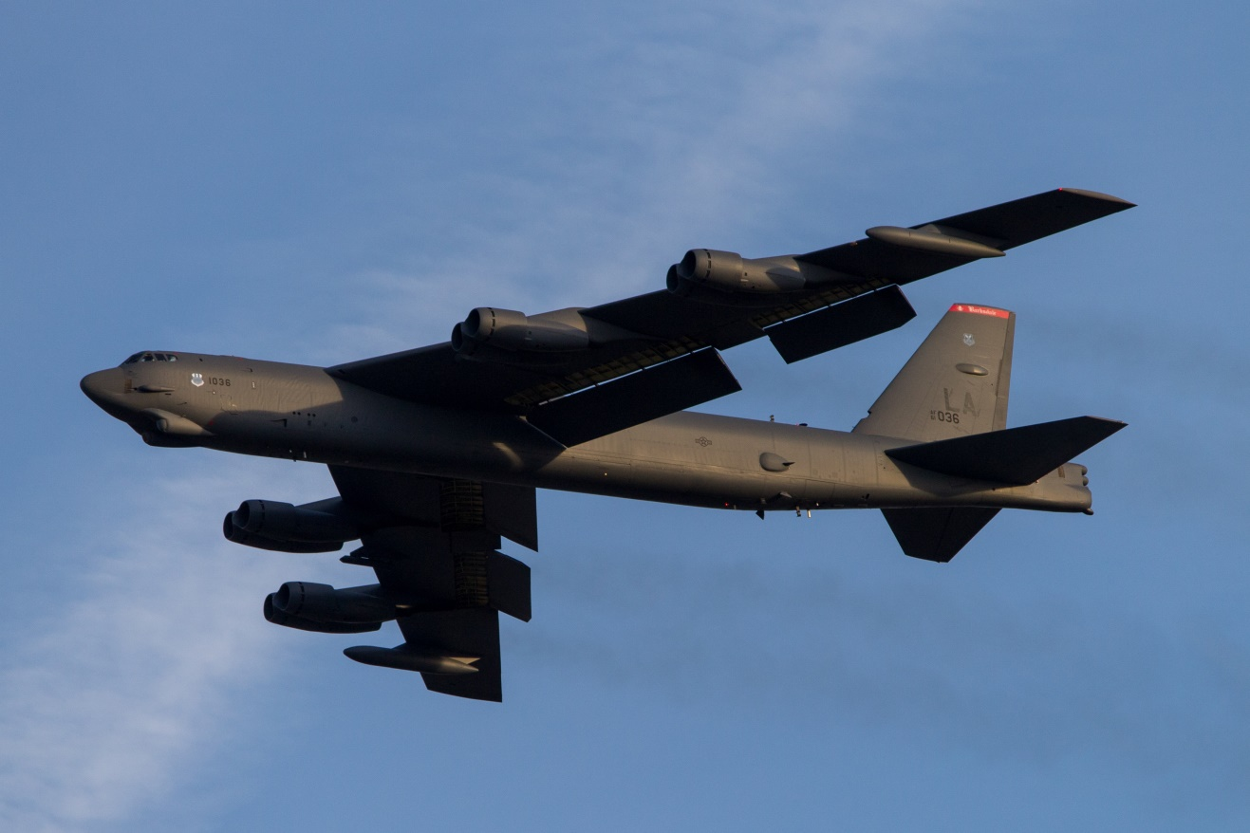
B-52 Stratofortress
The Politics of its very, very long life
Alex Haecker
System Test Engineer
Lockheed Martin Aeronautics Company, Fort Worth, Texas
Notes:
I work for Lockheed Martin in Fort Worth on the F-16 program, so my technical focus is on much, much smaller platforms!
BS Aerospace Engineering University of Texas at Austin
I have not had any affiliation with this program
I was fascinated by this program longevity and it’s continued use in theater (as an engineer for a “legacy” program myself)
Part of my fascination stems from my involvement in the F-16 program, which has had a long life of its own

Slide 2
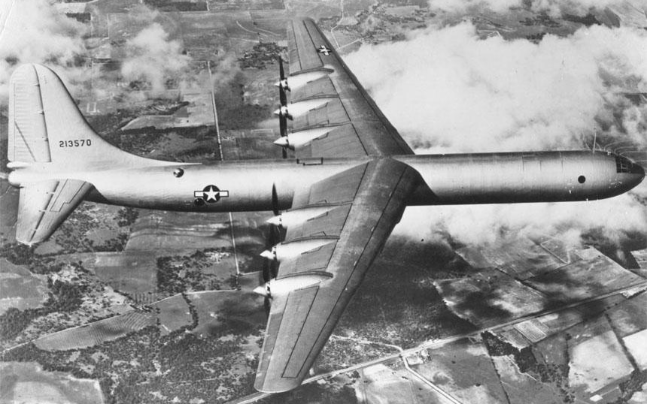
Beginnings
Convair B-36: original long-range, high altitude bomber
conceived during WWII
  Not delivered until 1948, after the War!
  Already obsolete – too slow
Soviet Union now the greatest threat to US
Technology advancements demanded
  Jet engines
  450 mph top speed
  Maintain at least 8,000 mi range
B-52 was the solution, with first B-52B operational in 1955
  Very last B-52H was produced in 1962
Notes:
B-36 interesting to me because it was built at the plant in which I work in Fort Worth, Texas
B-36 was the first bomber with truly intercontinental unrefueled range (8,000+ mi)
Jet engines necessary because enemy air forces now have jet fighters to chase down bombers
Start of the Cold War meant key capability was nuclear strike – long range, high speed, high endurance
YB-52 First Flight occurred on 15 April 1952
B-52As were all used for testing
More than just a replacement for B-36, the B-52 represented an entire operational “upgrade” for Air Force.
Newer, longer, more durable runways required

Slide 3
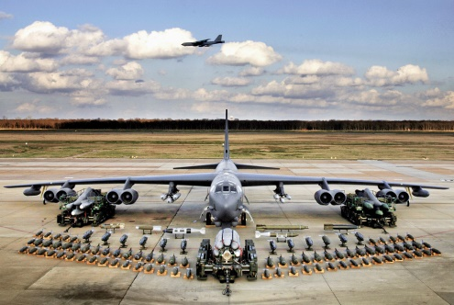
Post-Vietnam Era
Today: 76 Boeing B-52Hs remain in USAF fleet expected to serve until 2040 (85 years of service)
  A current B-52 pilot could be flying the same aircraft his grandfather flew
  The last B-52 pilot has likely not
  been born yet
Why is this 1940s program still with us?
  PFOL #5: B-52 has proven to be a great
  political solution
  PFOL #2: Cost Rules
  PFOL #4: B-52 “Replacements” suffered technical problems at the right time
Notes:
B-52 already a “legacy” aircraft by Vietnam
B-52 had pivoted from its original 24/7 nuclear readiness missions to a more conventional penetration bomber
The post-Vietnam success story of the B-52 is really the story of other program failures and geo-political timing

Slide 4

B-1 Bomber (1970s)
Significant technical advantages over B-52
  Supersonic entry into Russian airspace to outrun fighter/SAM defenses
  About 1/50 radar cross section (RCS) of B-52, with similar payload
  Variable sweep wings allow shorter takeoff and landing
PFOL #3: Constituency
  B-52 sustainment spread wide across congressional districts
  Anti-B-1 constituency becomes part of B-52 constituency
  “The National Campaign to Stop the B-1 Bomber”
PFOL #4: Technical problems become political problems. Flight test delays on B-1 cause Senate ASC to propose Culver Amendment
  Delays procurement funding until 1977, (after Carter inauguration)
  Goldwater: Opposed delay, citing that B-1 would have $492 million added to its cost due to the delay
Notes:
B-1 Constituency
Totally committed to the plane were the Air Force; the 1,544,850-strong United International Union of Automobile, Aerospace and Agricultural Implement Workers of America (UAW); the prime contractor, Rockwell International; other contractors and subcontractors; a large contingent of members of Congress, including high-ranking members of the House and Senate Armed Services and Appropriations committees; and the Ford administration. The AFL-CIO leadership also stated their support for the B-1
Fervently opposed to the B-1 was a coalition of some 36 religious, environmental, consumer, citizens', peace and labor groups that coordinated their efforts under the banner of “The National Campaign to Stop the B-1 Bomber.” They were joined in their effort by an initially rather small group of members of Congress and their aides who had consistently opposed the B-1 since it was first proposed.
Sen John Culver (D – Iowa) proposed his amendment to delay the B-1 decision until after the presidential election of 1976. This was after a previous amendment to completely ax the B-1 had been rejected narrowly in the senate.
Sen Barry Goldwater (R – Ariz) opposed Culver and cited $492 increase due to delay.
Carter elected in 1976 opposed B-1 from start, waivered throughout 1977, but ultimately solidified in opposition to B-1
FB-111H was considered a replacement for the supersonic capabilities of the B-1

Slide 5
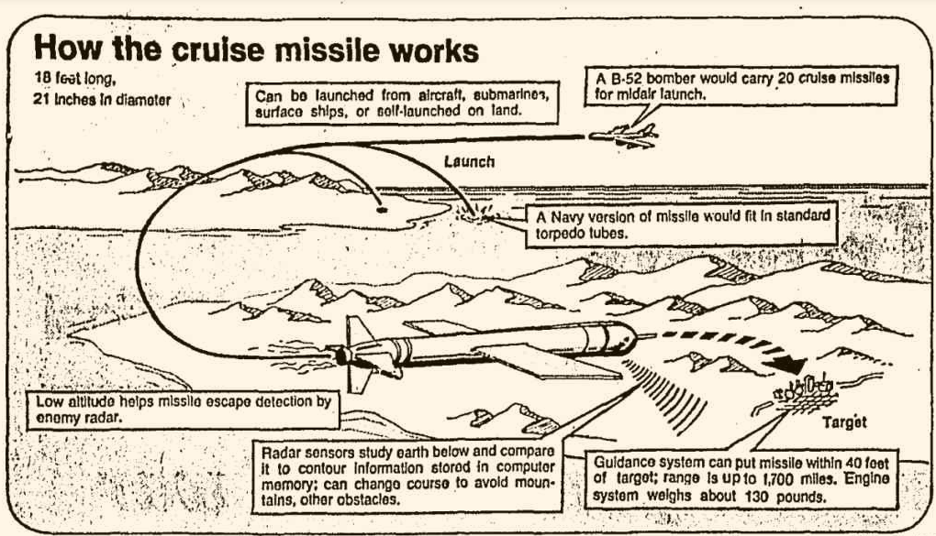
Cruise Missiles Boost B-52
FY1977: $462 million passed for 3 production B-1s
…but, in late 1977, problems occur in development and new cost estimate is $101 million per plane
President Carter decides
cheaper Cruise Missiles
are the preferred technology
  Becomes AGM-86 program
  PFOL #2: Cost Rules
Carter officially ordered B-1 terminated June 30 1977
  Congress votes to rescind $462 million from FY 1977
  Instead, $91.6 million for B-52 modernization, plus $15 million for the Cruise Missile and Bomber research in FY1978 budget
source: 1977 Chicago Tribune
Notes:
In FY1977 budget, congress armed services committee has move to terminate B-1 program, but it is rejected by voice vote
Argument: nation should not go into 1980s depending on aging B-52s for nuclear bomber force, and B-1 is better against radar.
Committee concludes based on GAO reports that B-1 bomber is “cost effective in terms of both reasonable and possible scenarios, and is meeting its major milestones”
Les Aspin (D Wis.) calls this decision a mistake saying B-1 is “wrong plane”
House goes on to pass $462 million for 3 production B-1s
B-1 occurred during SALT II talks, but these ultimately fell apart with Russian invasion of Afghanistan
B-1 debate was a politically charged situation for Carter, and by the end of his single term, he thought it better to let the next president decide

Slide 6
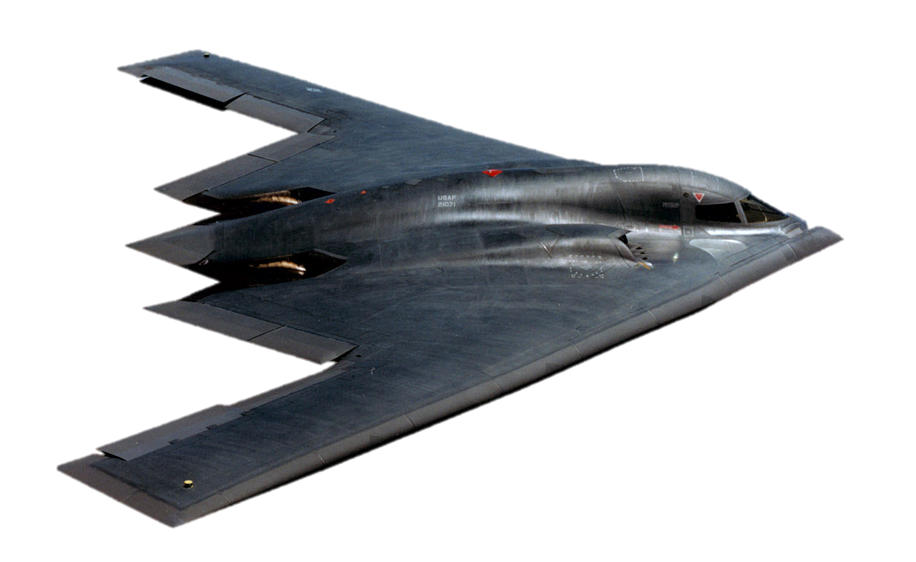
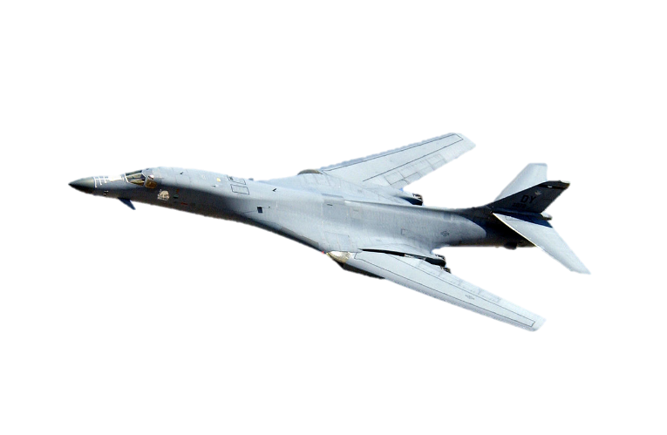

1980s and Defense Boom
Large congressional constituency still favored new manned bomber
  Jobs across hundreds of districts at stake from stalled B-1 program
1980: $600 million for Strategic Weapons Launcher (SWL)
  Committee: “we must have a hedge against the day when the B-52 becomes ineffective”
  In early 1978 Carter had already authorized the Advanced Technology Bomber (ATB) project in secret
1981: Both B-1 and ATB proceed during Reagan administration
  Reliance on B-52s as launch platforms “too risky” according to Defense Secretary Caspar W. Weinberg
  B-1B to be available by 1987 to bridge gap from B-52 to ATB
  B-52 to be phased out by the 1990s
Notes:
Congress raised Carter’s FY1979 defense budget by $1.3B, but raised his FY1981 defense budget by $5.9B – clearly at odds
Congress had defense contractors, unions, and many Russia-fearing citizens in its constituency
The Senate was divided into three factions on the issue of SWL: Morgan and the few others who favored the “stretched” FB-111B/C; those led by Glenn and John C. Culver, D-Iowa who favored letting the Pentagon develop an advanced-technology bomber; and those who still wanted the B-1.
Reagan planned to build 100 modified B-1 bombers to enter service by 1987, while continuing development of a new stealth bomber designed to elude Soviet detection. Carter's plan to rely on existing B-52s until the stealth planes were ready was too risky, Weinberger said, because of untested technical features of the new planes.

Slide 7
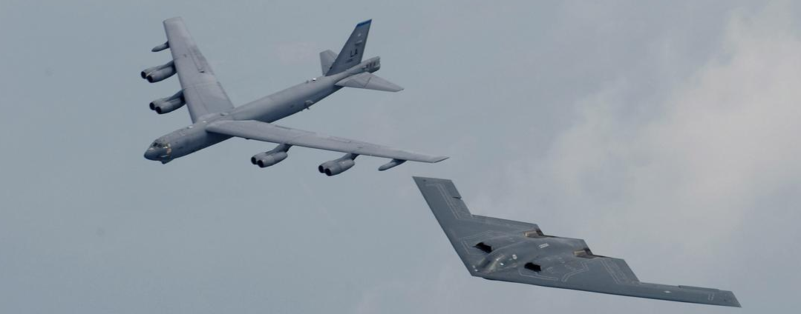
1990s to Today
Decline of Soviet Union threat
B-2 funding had come at expense of B-52 sustainment, but…
  PFOL #4: As B-2 encountered problems and cost growth, modification funding was won for B-52
  Stealth still involved Basic Research
1991: Gulf War is an operational success story for B-52’s continued conventional bombing capabilities
  PFOL #2: Cost Rules
40,000 LB
6,000 NMI
$135,000 /HR*
70,000 LB
7,652 NMI
$72,000 /HR*
*2012 Estimates
Notes:
Recall B-52 relied on stealth technology, which involved basic research (we know all about that)
Gulf War: B-1 and B-2 both existed to replace B-52’s nuclear deterrence capability against USSR, but did not anticipate competition for conventional bombing
B-2 was delivered in 1997, delayed and over budget
Most estimates of B-2 cost are $2B (including development cost) for each of the 21 aircraft built. Planned fleet size was originally 132
2000s: B-52 had the highest mission capable rate during Operation Iraqi Freedom (80% vs 30% for B2 and 60% for B1)
PFOL #4: Technical Problems become Political Problems

Slide 8
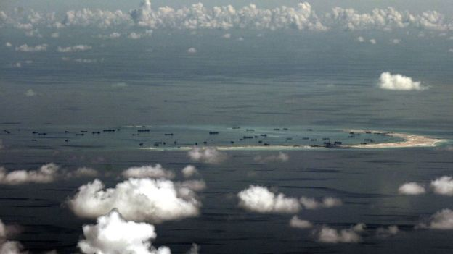
B-52 Life Summary
1958 – 1965: 24/7 “airborne alert” nuclear missions
1965 – : Conventional bomber
1978 – : Cruise Missile platform
1991: Nuclear alert missions ended for good finally
  All variants retired save for the B-52H
2013: B-52 CONECT Upgrades $1.1B
Nov 2015: B-52 flies over contested
waters in South China Sea
2015: $21.4B Long Range Strike Bomber contract award
  Estimated IOC of 2025
Notes:
CONECT – “Combat Network Communications Technology” for modernization avionics and radios
LRSB is said to replace B-52 fleet entirely as well as possibly replace B-1Bs. It will complement B-2 fleet.
The USAF continues to rely on the B-52 because it remains an effective and economical heavy bomber in the absence of sophisticated air defense, particularly in the type of missions that have been conducted since the end of the Cold War against nations with limited defensive capabilities

Slide 9
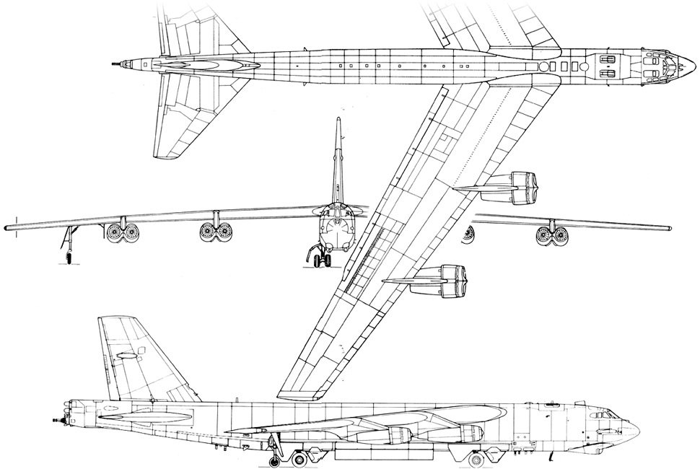
Questions?
Primary Research Sources
  Defense News
  Congressional Records and Reports
  DoD Declassified Documents
Image Source: http://gearpatrol.com/2014/09/03/history-of-the-b-52-flying-fortress/

Slide 10
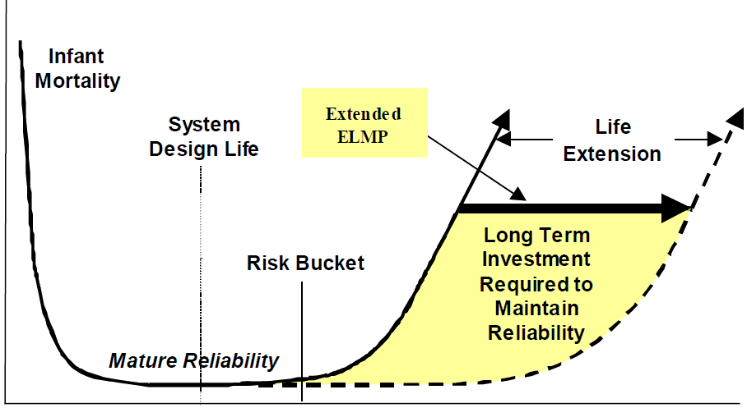
To Consider: Cost of Service Extension
Risk
Years
source: Jones
Notes:
I call this the “framework” of the analysis because at each juncture where congress/USAF has chosen to extend B-52, we make this cost decision

Slide 11
Notes
Nunn-McCurdy Breach is a PFOL #1 (politics controls) as well as a PFOL #2 (cost rules) example
PFOL #4 (engineering solutions not necessarily political) lead to PFOL #1
http://gearpatrol.com/2014/09/03/history-of-the-b-52-flying-fortress/
http://www.airpower.maxwell.af.mil/airchronicles/aureview/1982/nov-dec/boyne.html
http://www.theatlantic.com/national/archive/2012/03/why-cant-the-air-force-build-an-affordable-plane/254998/
http://www.nytimes.com/2015/12/06/us/b-52s-us-air-force-bombers.html?_r=0
http://archives.chicagotribune.com/1976/05/21/page/9/article/senate-puts-off-b-1-decision
Notes:
“In fiscal 1945, the last year of World War II, U.S. expenditures for the defense establishment reached a peak of $79.9 billion… in 1948, defense spending hit its post-war low of $11.1 billion.” (congress)

