Slide 1
Middle East Crisis Solution: War or Democracy?
Case of Iran’s Nuclear Deal
Ali Ghahramani
PhD Candidate in Informatics for Intelligent Built Environments
MS CS, MS ISE, MS CE
SAE 550 – 3/21/2016

Slide 2
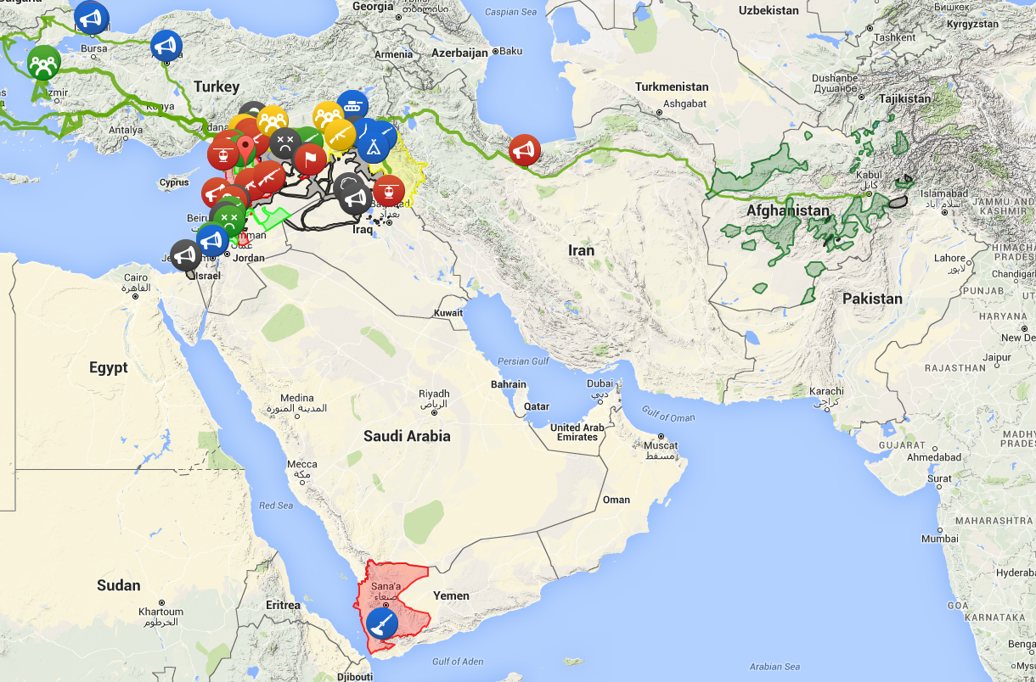
Middle East Crisis
70 years of conflicts
Religions ideological diversity
49% of the world’s oil reserves
30% of the current oil production
Key Players:
  United States (2-party)
  Russia (1-party)
  Turkey (1-party)
  Iran (2-party)
  Saudi Arabia (1-party)
  Israel (2-party)
http://mideast.liveuamap.com/

Slide 3
A Quick Sketch
1st Nuclear Reactor
Revolution
Hidden enrichment facilities
Paris Agreement
Ahmadi Nejad
1967
1979
Sanctions
2004
2005
1st Uranium Enrich.
5+1
Meetings - Sanctions
Rouhani
Joint Plan of Action
2006
2013
2014
2016
“Iran would redesign, convert, and reduce its nuclear facilities and accept the Additional Protocol (with provisional application) in order to lift all nuclear-related economical sanctions”
Notes:
https://www.armscontrol.org/factsheet/Timeline-of-Nuclear-Diplomacy-With-Iran

Slide 4
Post Agreement State
Constituency
  Supporters: Left-wing parties in U.S. and Iran, Russia, Turkey, Majority of middle eastern countries, and U.N.
  Oppositions: Right-wing parties in U.S. and Iran, Israel, and Saudi Arabia
“Been on holiday to Iran? It will make US trips more expensive and stressful”
  “Iranian dual citizens fight new US visa rules”
  “New U.S. visa rules will have some Iran exceptions, irking GOP”
“Iran fires ballistic missiles a day after test; U.S. officials hint at violation”
  “John Kerry relayed Mohammad Javad Zarif the US concerns concerning reports about Tehran conducting ballistic missile tests.”
“Obama reassures Saudi Arabia over Iran”
“Obama Tries to Reassure Netanyahu on Iran Deal”
Notes:
http://www.telegraph.co.uk/travel/destinations/middle-east/iran/articles/Been-on-holiday-to-Iran-It-will-make-US-trips-more-expensive-and-stressful/
http://www.bbc.com/news/world-us-canada-35128684
http://www.politico.com/story/2016/01/us-visa-rules-posted-website-218054
http://www.cnn.com/2016/03/09/middleeast/iran-missile-test/
http://sputniknews.com/politics/20160309/1036039892/kerry-raised-iran-ballistic-missiles.html
http://www.usatoday.com/story/news/2015/09/04/obama-king-salman-bin-abd-al-aziz-saudi-arabia-iran-nuclear-deal/71697468/
http://time.com/3957628/obama-netanyahu-iran/

Slide 5
How the Deal could help in future?
“Syria peace talks: Opposition agrees to ceasefire after temporary truce negotiated by US and Russia”
  “Vladimir Putin orders Russian forces to begin withdrawal from Syria”
“Yemen ceasefire begins as warring sides gather for peace talks”
  “Yemen conflict: Saudi-led coalition ends ceasefire”
  “Yemeni officials say Shiite rebels and the internationally recognized government have agreed to begin a ceasefire for a week or two before their next round of negotiations”
“Terrorists VS terrorists: ISIS in ‘direct rivalry with Taliban in Afghanistan,’ UN says”
Notes:
http://www.independent.co.uk/news/world/middle-east/syria-peace-talks-opposition-agrees-to-ceasefire-after-temporary-truce-negotiated-by-us-and-russia-a6890611.html
http://www.theguardian.com/world/2016/mar/14/vladimir-putin-orders-withdrawal-russian-troops-Syria
http://www.cnn.com/2015/12/15/middleeast/yemen-conflict-ceasefire/
http://www.bbc.com/news/world-middle-east-35214099
http://www.usnews.com/news/world/articles/2016-03-20/yemeni-officials-say-government-rebels-agree-on-ceasefire
https://www.rt.com/news/327348-taliban-isis-confrontation-afghanistan/

Slide 6
Universal Facts of Life
Politics, Not Technology, Controls What Technology Is Allowed To Achieve
  Iran’s nuclear program is limited to almost only a research program. Power reactors need to wait for about 15 years.
Cost Rules
  If an agreement was not reached, a potential war would results in extreme costs for the not only U.S., but the world.
A Strong, Coherent Constituency Is Essential.
  5+1 took the agreement to U.N. security council for a comprehensive approval.
The Best Engineering Solutions Are Not Necessarily The Best Political Solutions
  Enrichment percentile and mass required for supplying Iran’s reactor could potentially reduce breakout time.

Slide 7
Universal Facts of Life
Timing Is Everything
  Two left-wing parties in power aiming for moving forward
Politics Prefers Immediate, Near-Term Gratification
  Iran’s conservative could not accept suspending nuclear program with sanctions
Politics Believes In Gurus And Heroes
  Iranian’s diplomats are treated as heroes
Middle Eastern Facts of Life
  Ideology rules. (Formed at the time of revolution or overthrown)
  Revolution and overthrowing even corrupted governments only make things worse. (Terrorists seek a region with a small instability to turn it into real chaos)
  Chaos secures power. (Iran, Turkey, and Saudi Arabia)

Slide 8
Questions?

