Slide 1
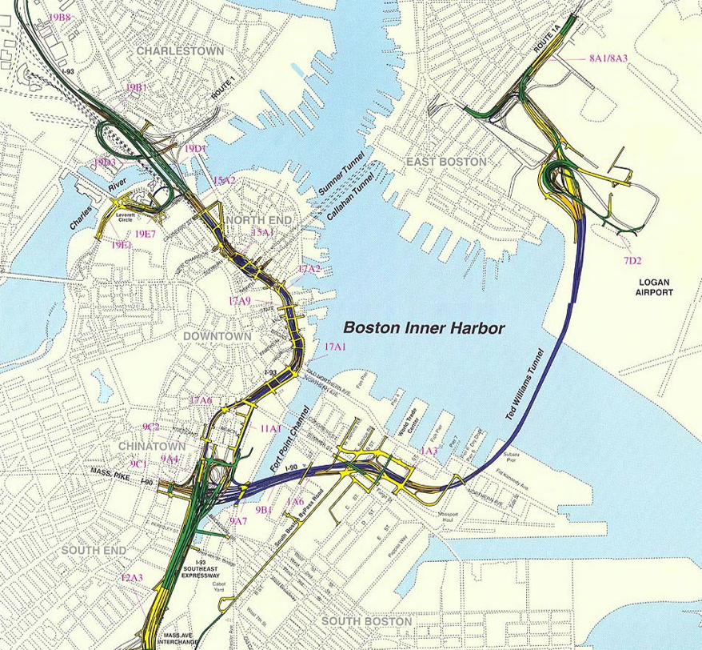
SAE 550, Spring 2016
Boston Big Dig
Politics & The
Central Artery/Tunnel Project (CA/T)
Christopher Cunha
Figure Source :http://www.massdot.state.ma.us/
March, 2016

Slide 2
Overview
Boston’s Central Artery/Tunnel development project, commonly known as the “BIG DIG”, was the most expensive highway project in U.S. history at $14.7 billion
  Initial estimate $2.6 billion in 1985
  Final cost with interest estimated to be $22 billion
Project Goals
  Connect Logan Airport to I-90
  Eliminate the Elevated Expressway through the center of the city > Reconnect/Revitalize city waterfront
  Tunnel under the city and Boston Harbor
  Business “as-usual” during construction & no eminent domain
Congress passed public works bill in 1987, ground broken in 1991, “completed” in 2007

Slide 3
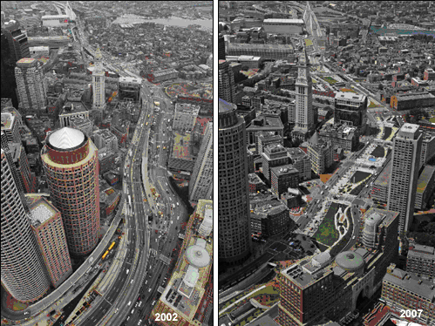
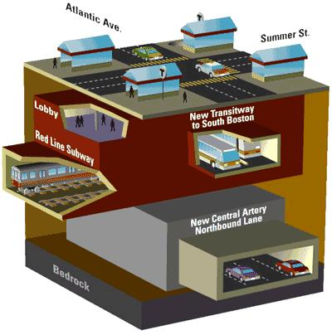
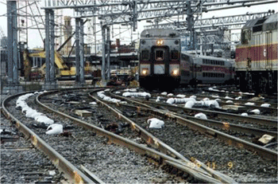
Overview – Technical Feats
Tunnels, Tunnels, Tunnels
  Boston Harbor
  Fort Point Channel
  Red Line Station
  Under the Elevated Expressway
South Station Landfill
Zakim Bridge
  Widest cable-stayed bridge in the world
Fig. Source : http://spacing.ca/toronto/2007/12/31/the-end-of-bostons-big-dig/
I-93
Zakim Bridge
Logan Airport
Ted Williams Tunnel
I-90
South Station Tunnel
Fort Point Channel Tunnel
Fig. Source : http://www.engineering.com/content/community/library/marvels/thebigdig/images/gwred04.jpg
Fig. Source : www.archboston.com

Slide 4
The Players
Fred Salvucci
  Secretary of Transportation
  Conceptualized the idea with the Boston Transportation Review Plan Board
  Rallied the public and lobbied congress for funding
Mike Lewis
  Project Director
Bechtel Corporation (Largest U.S. Civil Engineering Company)
  Primary management consultant
Massachusetts Turnpike Authority
Massachusetts Commonwealth
Governors > Dukais, Weld, Cellucci, Switt, Romney

Slide 5
Dominant FOLs
A Strong, Coherent Constituency is Essential
Salvucci, an anti-highway activist, lobbied for Gov. Funding
  Boston Public > No eminent domain nor traffic rerouting
  Business Sector wanted better access Logan Airport
    Salvucci w/Dukakis tied Logan tunnel project to Big Dig
    Business to remain as usual during construction
Congress passed public works bill in 1987
  Vetoed by President Ronald Reagan (Too Expensive!)
Bechtel Corporation had two of its board members in the President Cabinet: Sec. of State Shultz, Sec. of Def. Casper
Tip O’Neil, Speaker of House, MA Rep. and Ted Kennedy, MA Senator, turned 1 vote in Congress to overturn Veto
Notes:
Politics, not technology, controls what technology is allowed to achieve
Cost Rules
A strong, coherent constituency is essential
Technical problems become political problems
The best engineering solutions are not necessarily the best political solutions

Slide 6
Dominant FOLs
Technical Problems Become Political Problems
Ted Williams Tunnel 3 feet to short
Fort Point Channel leak during construction
I-93 tunnel leaks
  Accusations of shoddy construction work and substandard material use
  Death of Milena Del Valle in 2004
The Best Engineering Solutions Are Not Necessarily the Best Political Solutions
Propose Scheme Z plan for Charles River crossing rejected
North End Resident Mitigation Agreement
Trench & Cover depressed expressway under the old and open Central Elevated Expressway
Notes:
Politics, not technology, controls what technology is allowed to achieve
Cost Rules
A strong, coherent constituency is essential
Technical problems become political problems
The best engineering solutions are not necessarily the best political solutions

Slide 7
Notes of Interest
5,500 people employed every day on the Big Dig at a cost of about $3 million per day
Archeological gold mine of remnants dating back to the 16th century from digging into land fill digging
24/7 Traffic monitoring system, one of the most sophisticated in the world
Bechtel Corporation paid $2.6 Billion for services (more than the entire initial estimate of the Big Dig)
Lawsuits
  Bechtel Corp. settled for $352 million
  Parsons Brinkerhoff settled for $47 million
Notes:
Politics, not technology, controls what technology is allowed to achieve
Cost Rules
A strong, coherent constituency is essential
Technical problems become political problems
The best engineering solutions are not necessarily the best political solutions

Slide 8
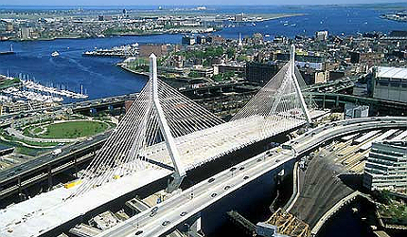
Source : http://static.progressivemediagroup.com/
QUESTIONS?
Notes:
Add Speaker Name Here

Slide 9
Appendix
ADDITIONAL INFORMATION
Notes:
Add Speaker Name Here

Slide 10
Research
Engineering of
Documentaries
Project Profiles
Politics of
Books – political bibliographies, government projects
Settlement Cases
Government records and articles
Challenges
Political Bias
Cost Rules Examples

